Slide 1


DATA CONTROL LANGUAGE (DCL)

Slide 2
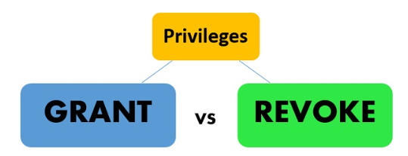
DCL Privileges

Slide 3
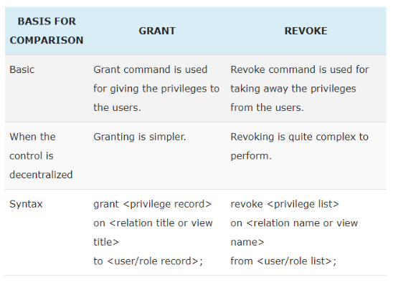
DCL Privileges

Slide 4
Conclusion
The grant command is used to gives the privileges or access to the users on the database objects. On the other hand, REVOKE command is used for removing the rights or privileges from the users on the database objects.

Slide 5
Overall Conclusion
DQL(Data Query Language)
DML(Data Manipulation Language)
DDL(Data Definition Language)
TCL(Transaction Control Language)
DCL(Data Control Language)

Slide 6


Slide 7


